Slide 1
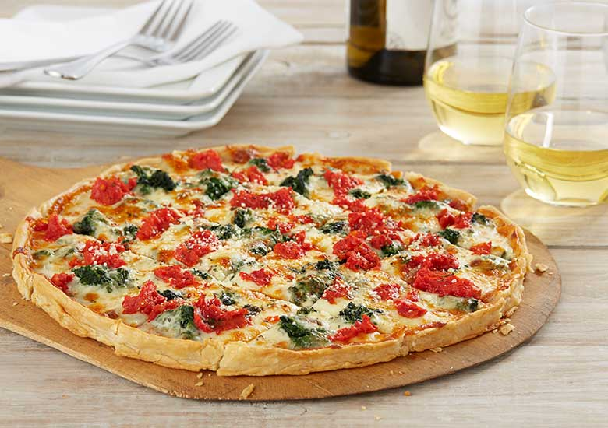
Where do you want to eat pizza??

Slide 2
Introduction
Pizza is one of the most loved food by almost everyone.
It is one of the favorite and you are willing to have the best pizza when you land to US.
We are going to show the areas with high density of restaurants of pizza and it is going to be our first meal when you will land United States.
The problem we aim to solve is to analyze the pizza store locations in the major US cities and find the best place for our tourists so that they can have the best pizza in the town.

Slide 3
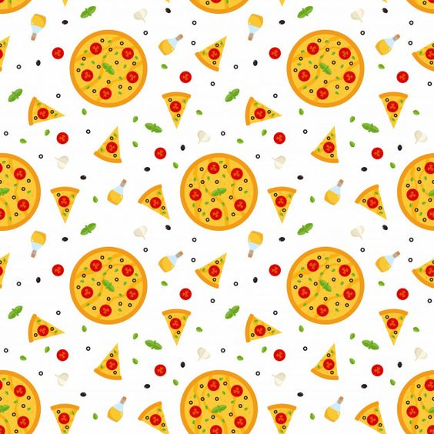
Data Section
I will use the FourSquare API to collect data about locations of Pizza stores in 5 major US cities which are: New York,NY,San Francisco, CA, Jersey City, NJ, Boston, MA and Chicago,IL.
My main target here is to asses which city would have the highest Pizza store density
These are one of the most populated US cities and I am hopeful that they will contain the best Pizza places in the US.
The data taken is precise and is easily understandable.
Pictorial representation makes it easy.

Slide 4
Methodology
I used the Four Square API through the venues channel.
I used the near query to get venues in the cities.
I use the CategoryID to set it to show only Pizza Places.
I have entered my credentials(client ID and Client secret ID) of Four square API.
Foursquare API provides a unique ID to every entity.
Foursquare limits us to maximum of 100 venues per query.
To highlight the places with the maximum density of Pizza places, I calculated a center coordinate of the venues to get the mean longitude and latitude values.

Slide 5
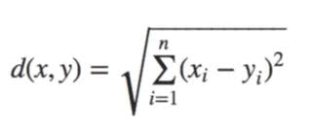
Then I calculated the mean of the Euclidean distance from each venue to the mean coordinates.
This is my indicator; mean distance to the mean coordinate.

Slide 6
Results
Initially, we see that they all have multiple pizza places and often more than Foursquare would like to supply us.
I have use the library folium for the pictorial representation.
Top 100 places of pizza restaurant in New York, NY = 282.
Top 100 places of pizza restaurant in Chicago, IL = 227.
Top 100 places of pizza restaurant in San Francisco , CA = 164.
Top 100 places of pizza restaurant in Jersey City, NJ = 120.
Top 100 places of pizza restaurant in Boston, MA = 187.
Here we can see clearly that New York has the most Pizza Places located.

Slide 7
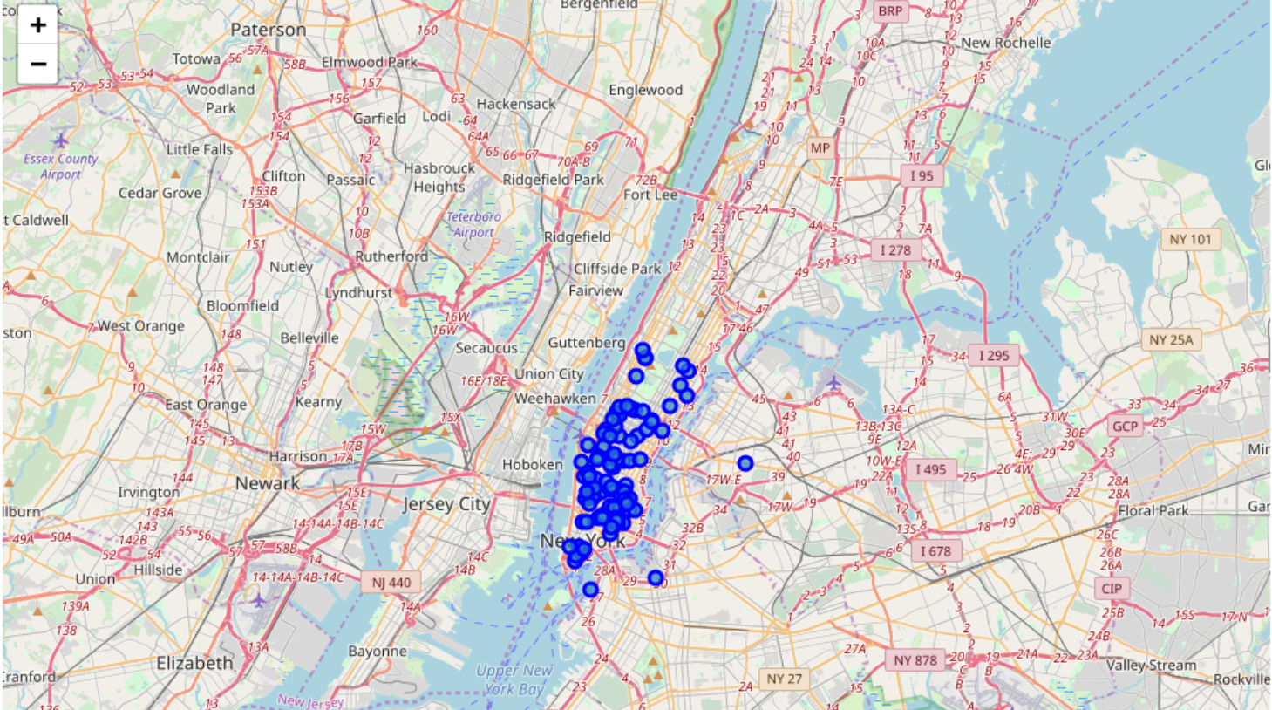
Pictorial Representation
New York:

Slide 8
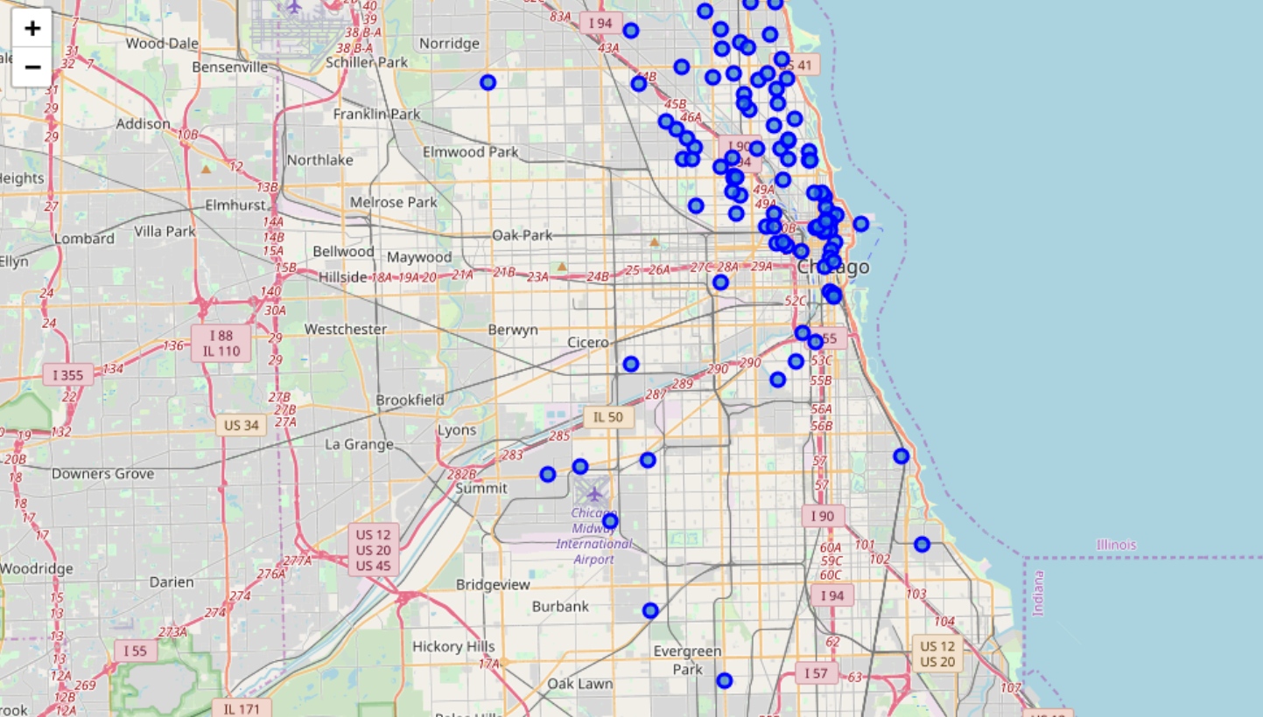
Chicago:

Slide 9
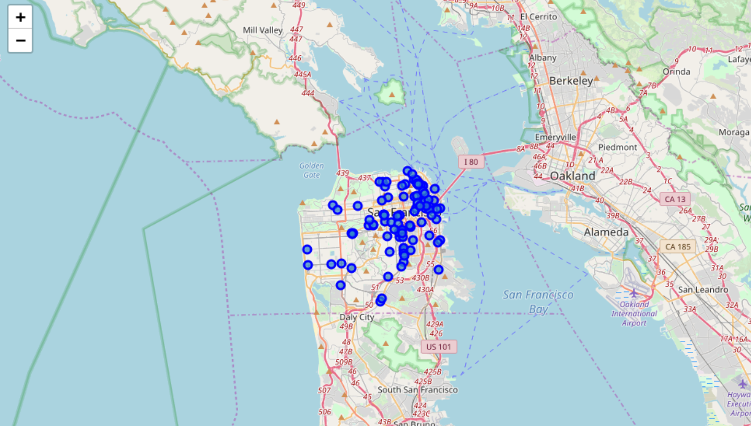
San Francisco:

Slide 10
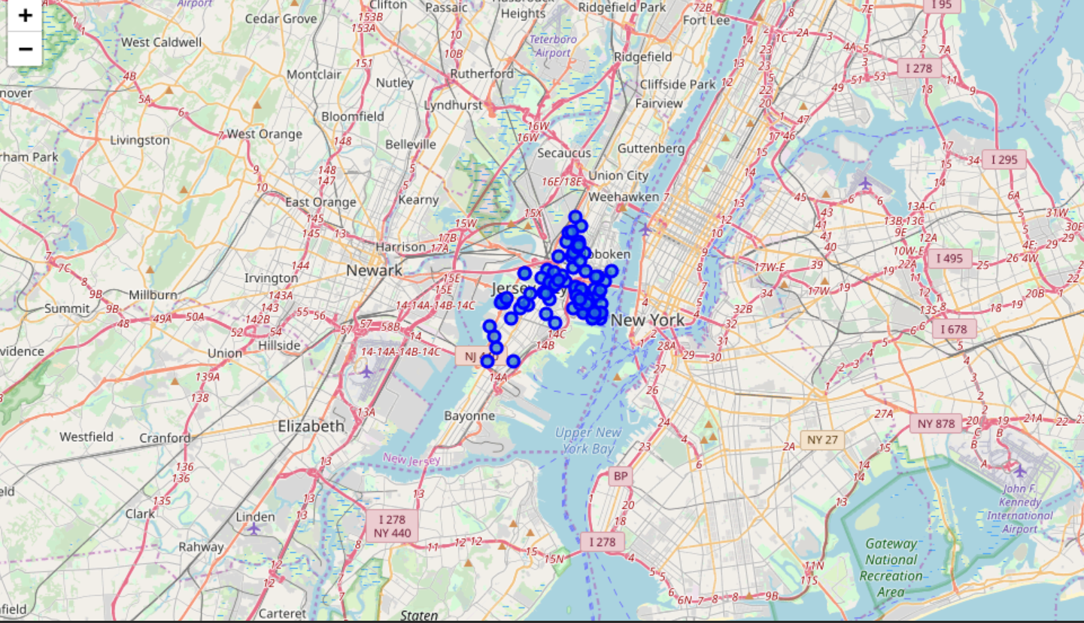
Jersey City:

Slide 11
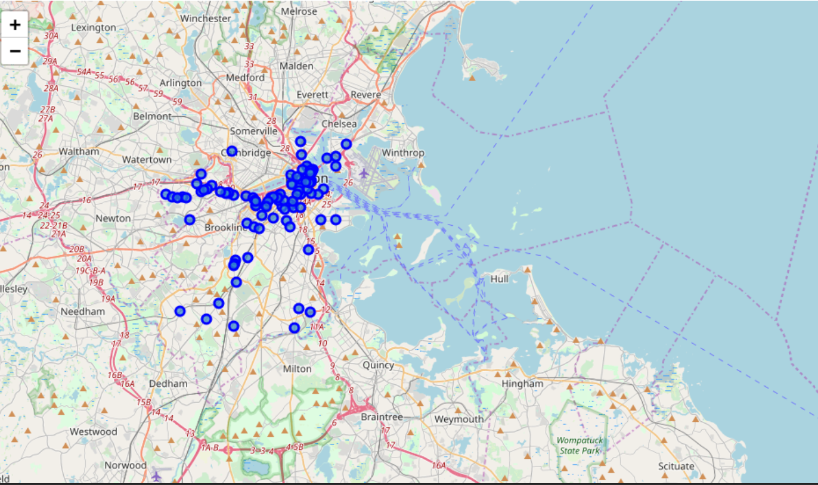
Boston:

Slide 12
We can see that New York and Jersey City are the most dense cities with Pizza places. And better than that, they are just one shore away.
Upon First inspection we see that New York, Jersey City and San Francisco are the most densely cities. In the next phase we Calculate the Mean coordinate and the mean distance to mean coordinate(MDMC). We represent the mean coordinate with a big green circle and distances with green lines.
We will now have a concrete measure of this density.
Some of the statistics will be used for getting the mean location of the pizza places which should be near to most of them if they are really dense or far if not.
Next step is to calculate the average of the distance of the venues to the mean coordinates.

Slide 13
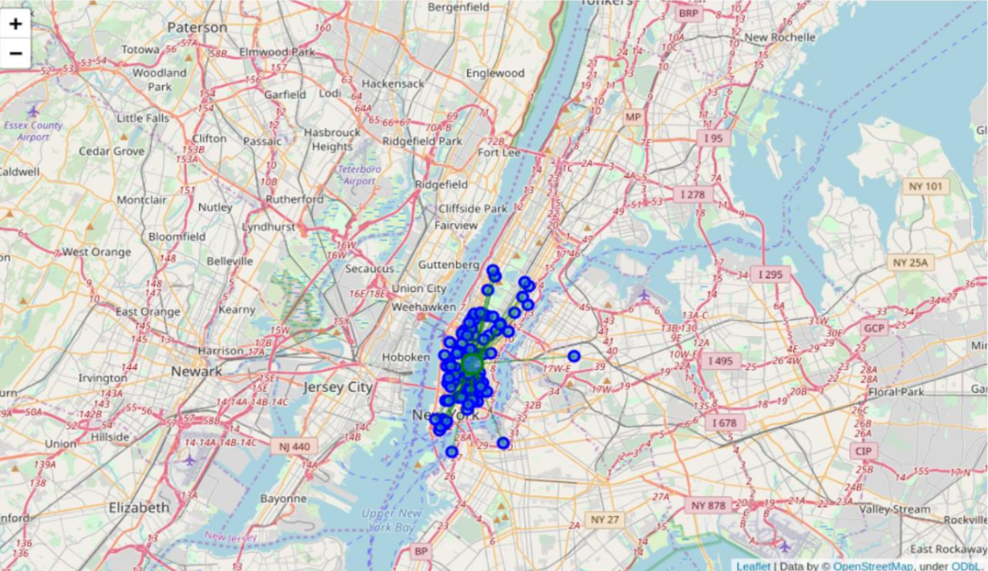
New York:

Slide 14
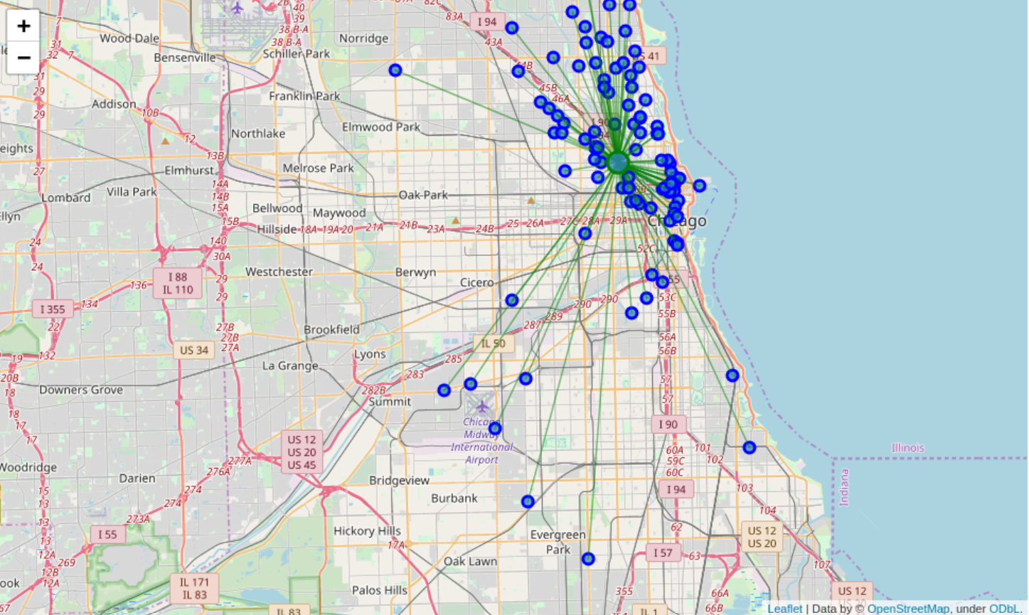
Chicago:

Slide 15
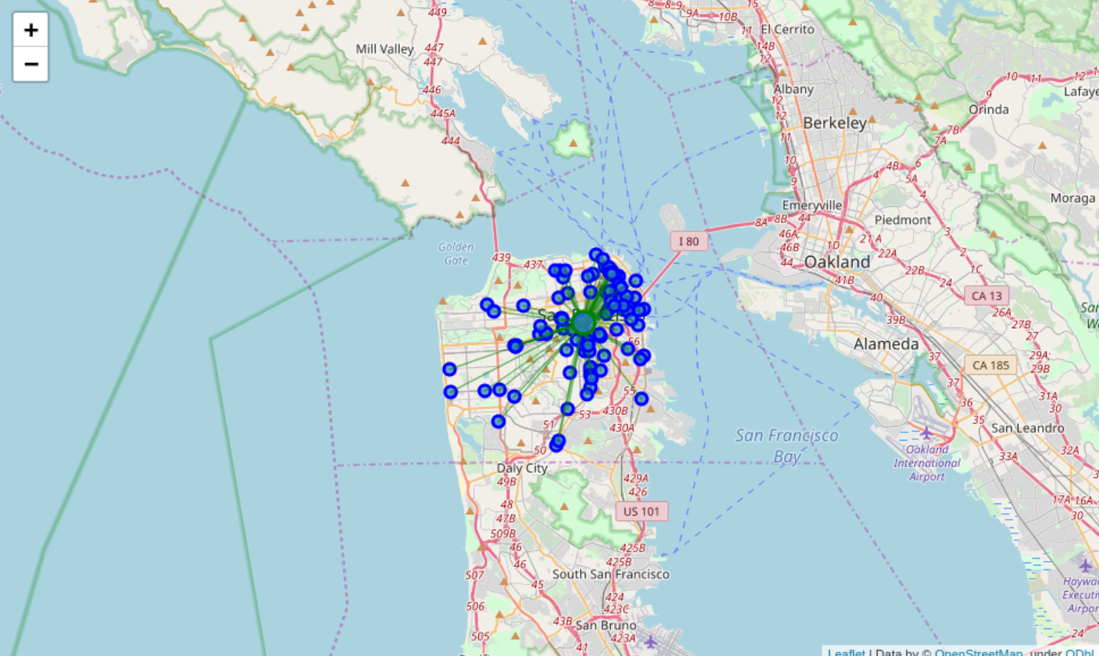
San Francisco:

Slide 16
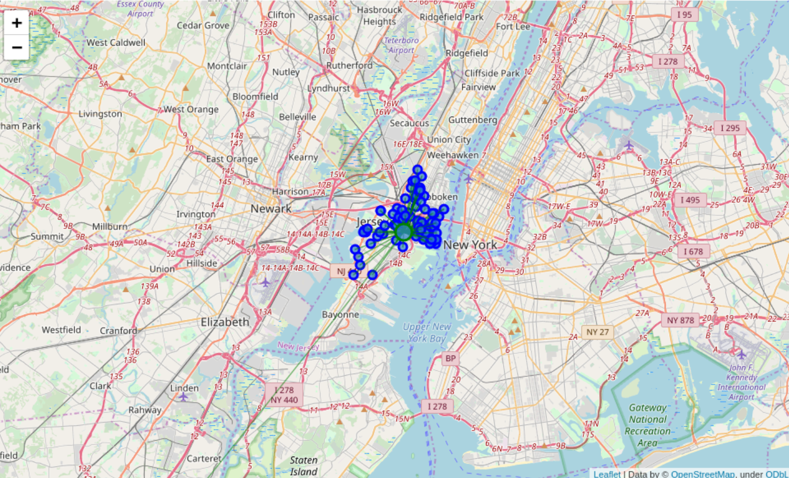
Jersey City:

Slide 17
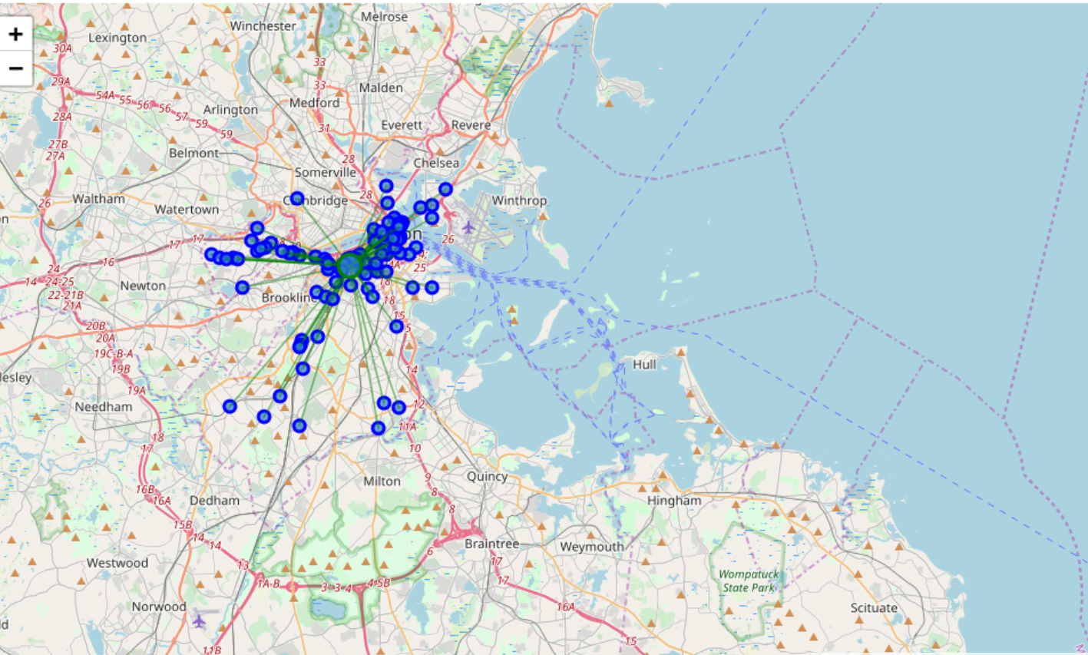
Boston:

Slide 18
Discussion
From the following pictorial representation there is a really far away Pizza Store in Jersey City that is probably giving it a higher MDMC.
So I checked what if I removed it, it would not harm anyone to try 99 pizza places than 100 and New York is just at the other shore.
The new MDMC was: 0.0219953, putting it one place up on the list replacing San Francisco.
One consideration to do further work on is to move the location of the Foursquare API query until we get all the pizza places in each city and do the calculations again.

Slide 19
Conclusion
Now there is no doubt that New York is the best place to try many Pizza Places in the US. Also, if our tourist is done with all the New York pizza places he can cross to Jersey City and enjoy 99 more.
And as aplus the Third best place is Jersey City which is just on the other side of the shore. Our tourist's best interest would be to book a hotel near that mean coordinate to surround himself with the 100 Pizza stores there!!
Another observation is that there is one really far away Pizza store which would possible increase its score to be beaten by New York So let's try to remove it and calculate it again.
That puts Jersey City back in the first place which makes our tourist happy.

